Slide 1
Virtual Reality Multiplayer Experience with Augmented Reality Spectator
Guide Name : Dr. Graceline Jasmine S Sivaraghavi U.R. 21BRS1412

Slide 2
Outline
Introduction
Problem Statement
Research Objectives
Proposed System
System Introduction
System Architecture
List of Modules
Module Explanations
Implementation and Results
Guide Approval
Research Paper Status
References

Slide 3
Introduction
Statement of Problem/Challenges
Immersive technologies like Virtual Reality (VR) and Augmented Reality (AR) are transforming industries such as retail, marketing, and education. However, developing robust multiplayer experiences for both VR and AR presents distinct challenges.
Currently, VR and AR multiplayer implementations are developed separately due to differences in interaction models, spatial tracking, and networking complexities.
Ensuring smooth, real-time communication, object synchronization, and user interaction across these platforms requires careful design and optimization.
This project focuses on building separate VR and AR multiplayer systems, addressing their unique challenges before eventually integrating them into a unified framework for seamless cross-platform interaction.

Slide 4
Problem Statement
Key Challenges
Multiplayer Synchronization: Ensuring real-time interaction across devices with minimal lag.
Networking & Latency: Maintaining stable connections and low-latency communication.
Object Synchronization: Keeping objects consistent across different users and environments.
AR Perception & Platform Differences: Handling real-world variations in AR tracking and interactions.
Cross-Platform Compatibility: Adapting to different hardware and industry needs.
Limited Documentation: Scattered or outdated resources make development harder.
Frequent Unity Updates: Constant changes impact stability and require ongoing maintenance.
Performance Optimization: Balancing graphics, physics, and networking for smooth gameplay.

Slide 5
Research Objective
Develop separate VR and AR multiplayer frameworks to address unique challenges in both environments.
Ensure real-time synchronization of player interactions, objects, and game states across networked sessions.
Optimize networking architecture for low latency, stable connections, and efficient data transfer.Implement reliable object synchronization to maintain consistency across AR and VR players.
Address AR-specific perception challenges, ensuring robust spatial tracking and interaction.
Design a modular and customizable system adaptable for industries like retail, marketing, and education.
Regularly update the system to maintain compatibility with Unity’s evolving XR and multiplayer frameworks.
Evaluate performance using metrics such as latency, synchronization accuracy, frame rate, and user experience feedback.

Slide 6
Proposed System
Proposed System Introduction
This system aims to develop separate VR and AR multiplayer frameworks, ensuring real-time interaction, synchronization, and adaptability for various industries like retail, marketing, and education.
Key Components of the System
VR Multiplayer System:
Player movement, interactions, and voice communication.
Object synchronization for real-time collaboration.
Networking using Unity’s multiplayer frameworks.
AR Multiplayer System:
Real-world spatial tracking and interaction.
Networked object placement and synchronization.
Optimized UI for mobile AR devices.
Synchronization & Networking:
Ensuring consistent game states across AR and VR.
Optimized network communication for low latency.
User Interface:
Customizable modules for different industries.
Simple room/lobby creation for multiplayer access.
Cross-platform support for various devices.

Slide 7
Proposed System
User Authentication
Lobby Creation and Joining
VR and AR Mode Selection
Multiplayer Synchronization
UI and Feature Enhancements
Object Interaction and Updates
Platform Perception Adjustment

Slide 8
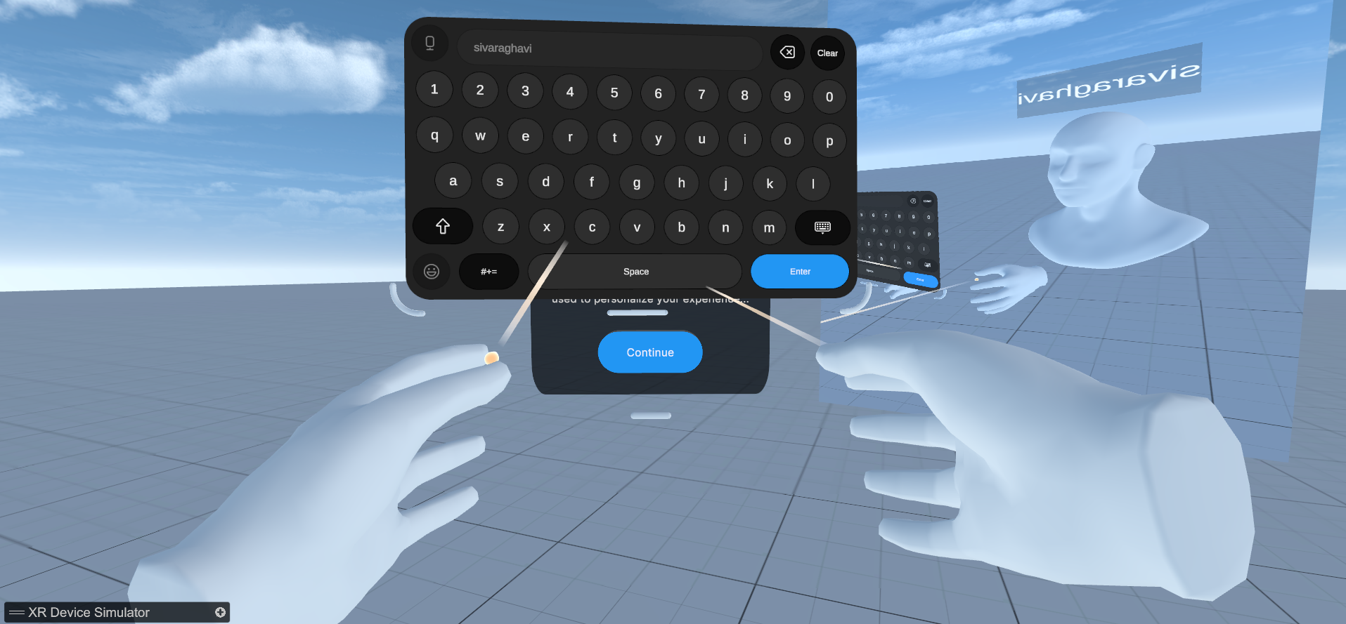
System Introduction
Introduces an innovative multiplayer VR/AR platform designed for immersive, real-time collaboration across diverse virtual environments, enhancing user engagement.
Leverages Unity for robust game development, Normcore for seamless networking, and Google ARCore to integrate AR features, creating a unified XR experience.
Targets practical applications including virtual product showrooms for interactive retail, customizable meditation spaces for mental wellness, and dynamic classroom settings for education.
Offers a dual-mode experience where VR users dive into 3D worlds with full immersion, while AR spectators join via mobile devices, interacting with the environment and other users in real time.

Slide 9
System Architecture
Utilizes Unity as the foundational engine, delivering cross-platform rendering, XR framework support, and high-quality visuals for both VR and AR modes.
Employs Normcore’s client-server architecture to ensure low-latency synchronization of avatars, objects, and voice across all connected users, critical for multiplayer functionality.
Integrates Google ARCore to enable AR spectatorship on mobile devices, overlaying virtual elements onto the real world with precise tracking and rendering.
Features a streamlined workflow: users join an XR session, connect to the Normcore server, create or join rooms, choose VR or AR roles, synchronize actions or views, broadcast updates to all clients, and update the XR world in real-time, as depicted in the included flowcharts.

Slide 10
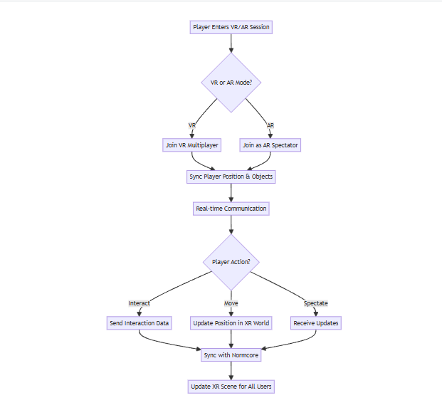
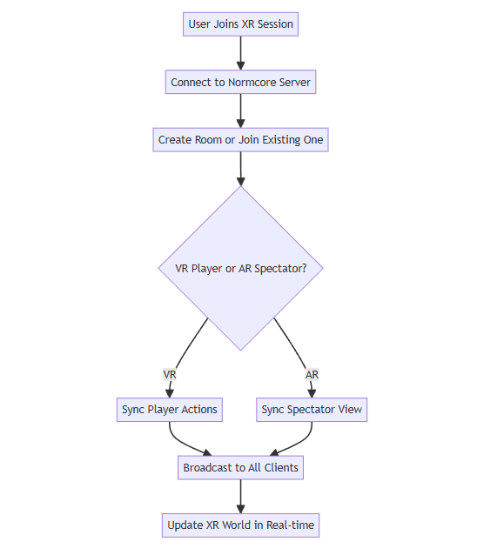
System Architecture

Slide 11
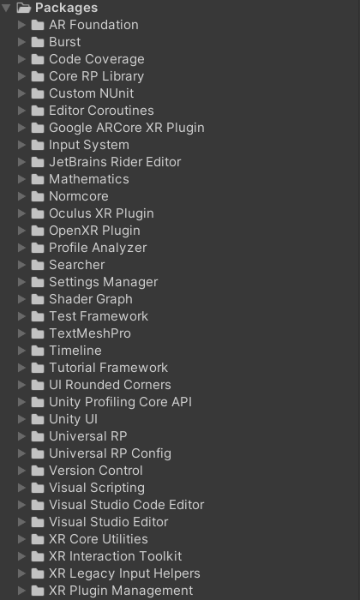
List of Modules
List of Modules
VR Multiplayer System
Built using Normcore for real-time networking.
Utilizes Oculus & XR Plugin Management for VR interactions.
Includes Meta XR Simulator for testing without a headset.
AR Multiplayer System
Uses Lightship for AR spatial tracking and multiplayer functionality.
Implements Parallel Sync for object synchronization across devices.
Networking & Synchronization
Real-time multiplayer interactions with optimized data transfer.
Ensures consistent object states between VR and AR users.
User Interface & Interaction
Customizable UI for different industries.
Simple room/lobby creation for seamless multiplayer access.

Slide 12
Module Explanations
Explanation of All Modules
VR Multiplayer System Purpose: Enables real-time multiplayer interactions in a virtual environment. Components Used:
Normcore for networking and player synchronization.
Oculus & XR Plugin Management for VR functionality.
Meta XR Simulator for testing without a headset.
AR Multiplayer System Purpose: Allows AR users to interact with virtual objects and other players in real-time. Components Used:
Lightship for AR spatial tracking and multiplayer interactions.
Parallel Sync to synchronize objects across multiple AR users.

Slide 13
Module Explanations
3. Networking & Synchronization Purpose: Ensures seamless, low-latency communication between players in both VR and AR. Techniques Used:
Real-time multiplayer networking using Normcore.
Synchronization of objects and interactions across different platforms.
4.User Interface & Interaction Purpose: Provides an intuitive and customizable UI for different industries. Components Used:
Room/lobby creation for seamless multiplayer access.
Cross-platform compatibility for VR and AR users.

Slide 14
Implementation and Results
Implementation: The project was developed using Unity with the XR Interaction Toolkit to support VR functionalities. Custom 3D environments for hospital, nature, and showroom scenarios were modeled in Blender and integrated into Unity. The setup includes teleportation, interactive object manipulation, and scene transitions. Testing was performed using a Meta Quest headset to ensure seamless navigation and intuitive interactions.
Results: Basic functionality was validated across all three environments. Users could interact with medical tools in the hospital, explore natural elements like trees and terrain in the nature scene, and navigate the showroom layout. Initial trials showed good spatial awareness, stable object interaction, and immersive feedback, with ongoing work to refine lighting, textures, and cross-platform support.

Slide 15
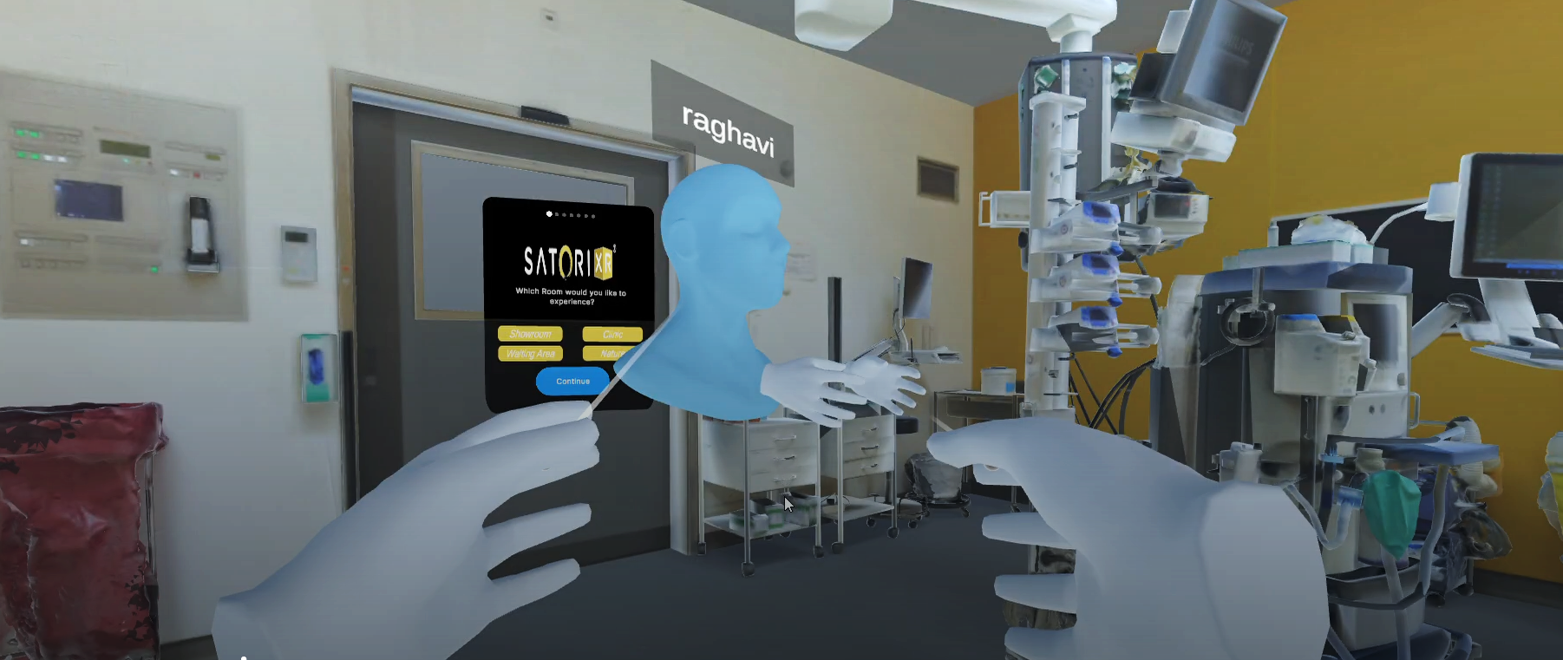
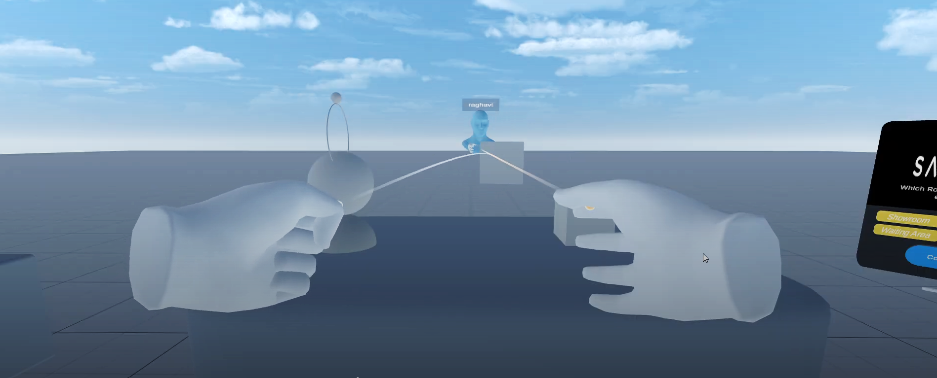
Implementation and Results
Multiplayer
Enables multiple users to connect and interact in a shared virtual environment in real time.
Object Synchronization
Ensures consistent object states and interactions across all connected users.

Slide 16
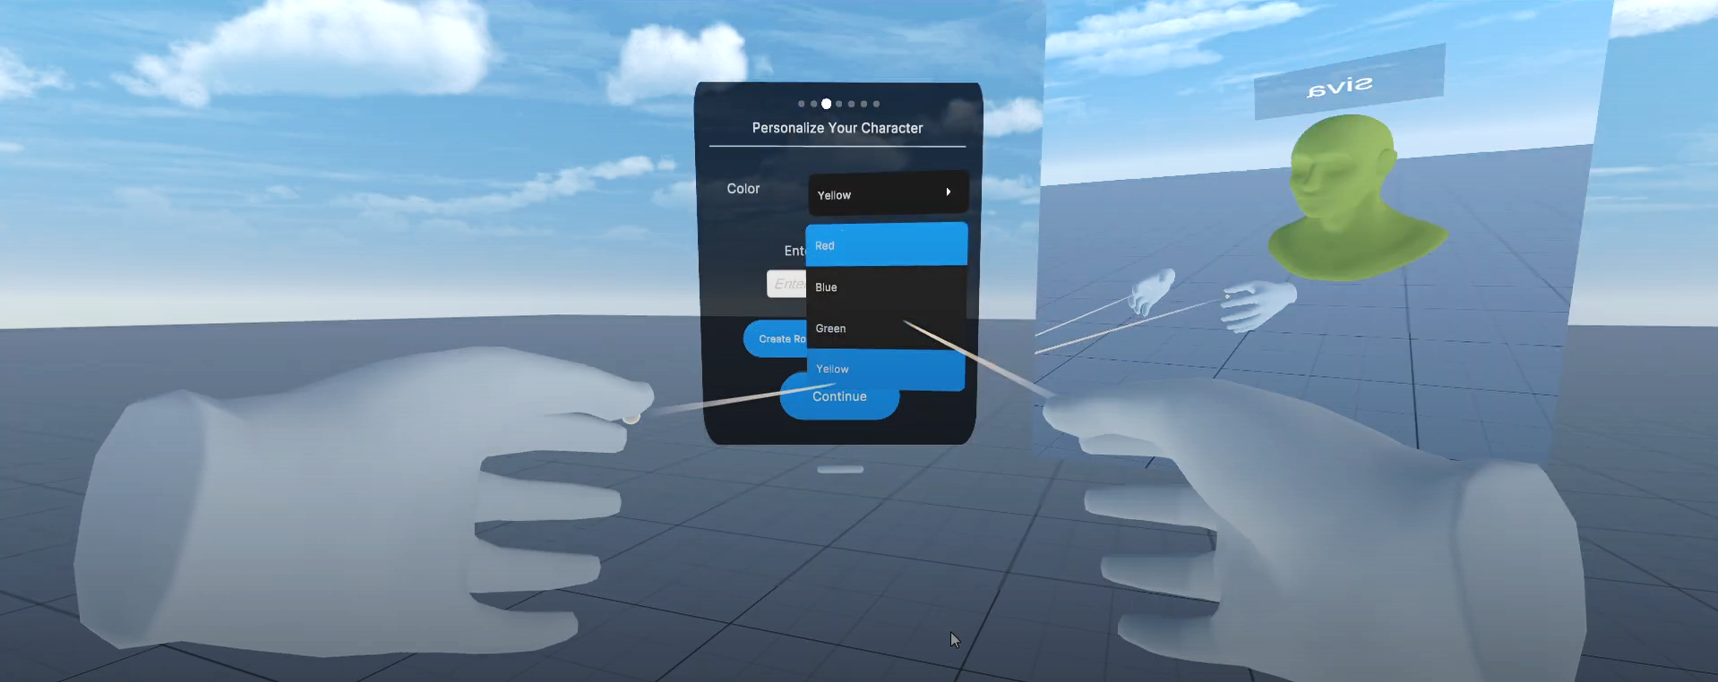
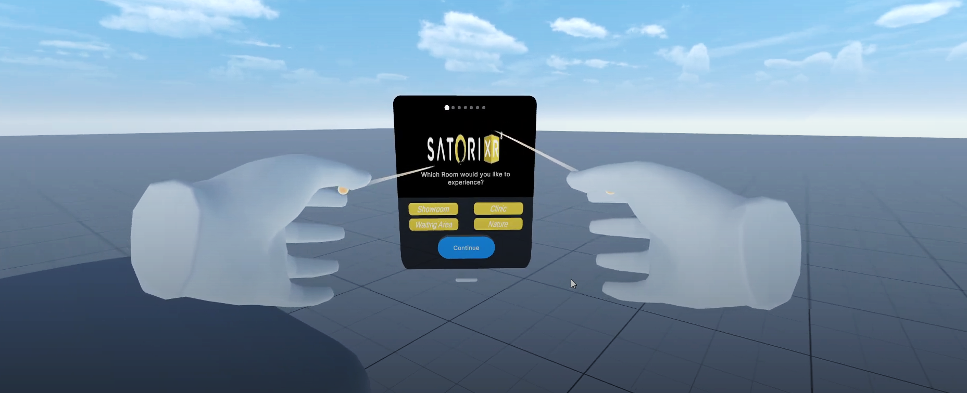
Implementation and Results
Avatar Customization
Allows users to personalize their virtual identity with custom colors and name tags.
Virtual Space Navigation
Lets the host switch between different virtual environments for all users instantly and in sync.

Slide 17
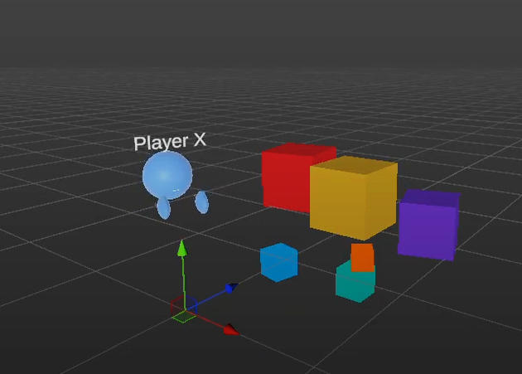
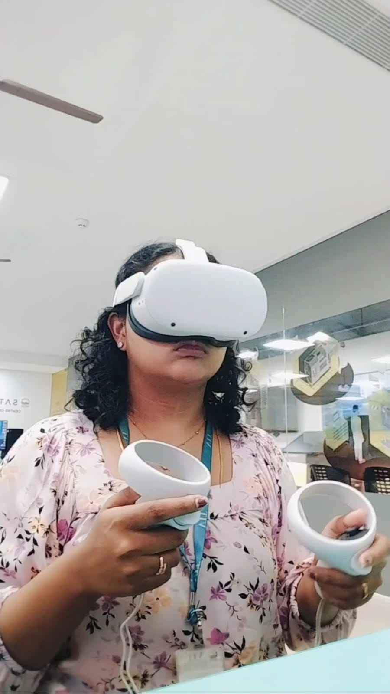
Implementation and Results
AR Spectator
Provides a real-time external view for observers

Slide 18
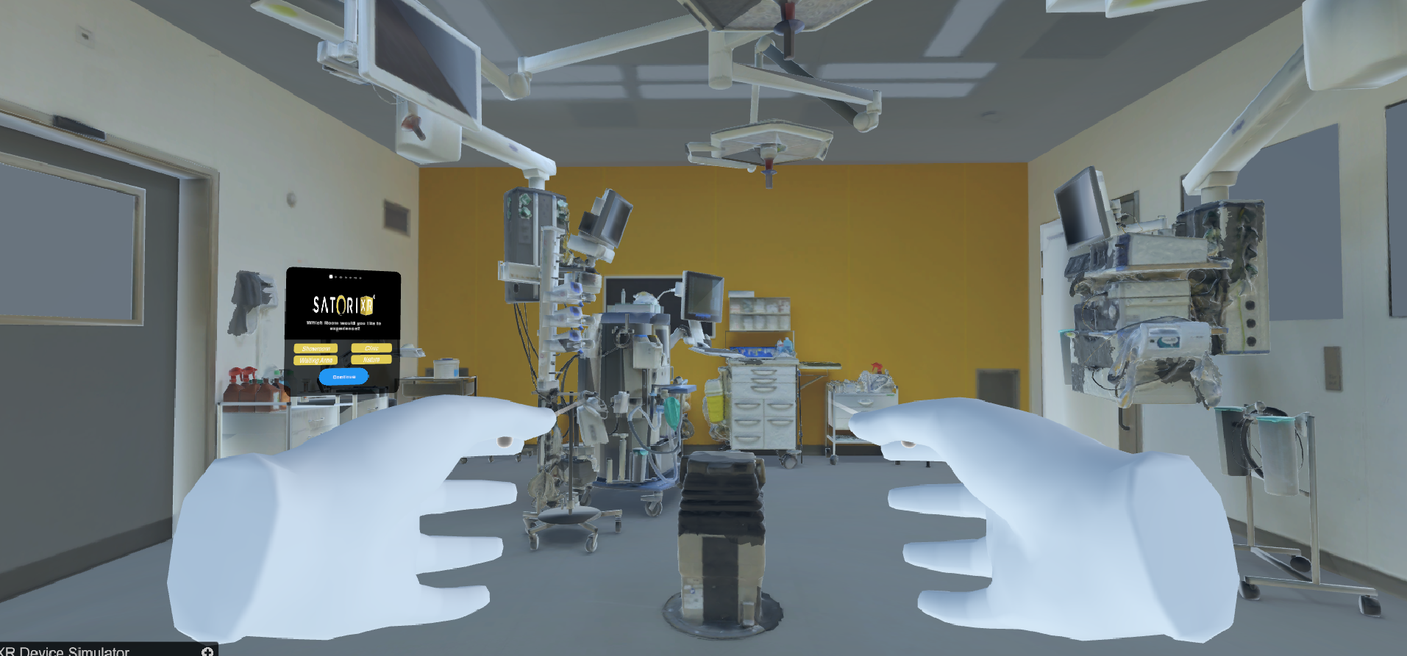
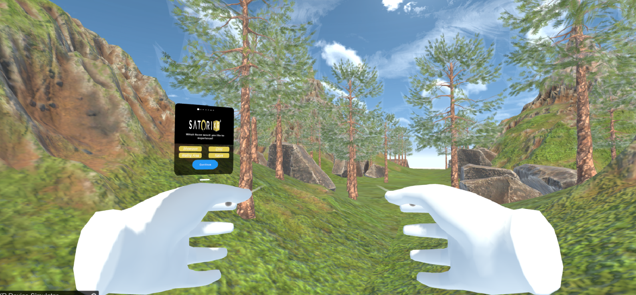
Implementation and Results
Use Cases
Hospital/Clinic Setup Provides a virtual training space for users to explore and familiarize themselves with medical instruments and procedures.
Nature Experience Simulates immersive natural environments for therapeutic or recreational multiplayer interactions.

Slide 19
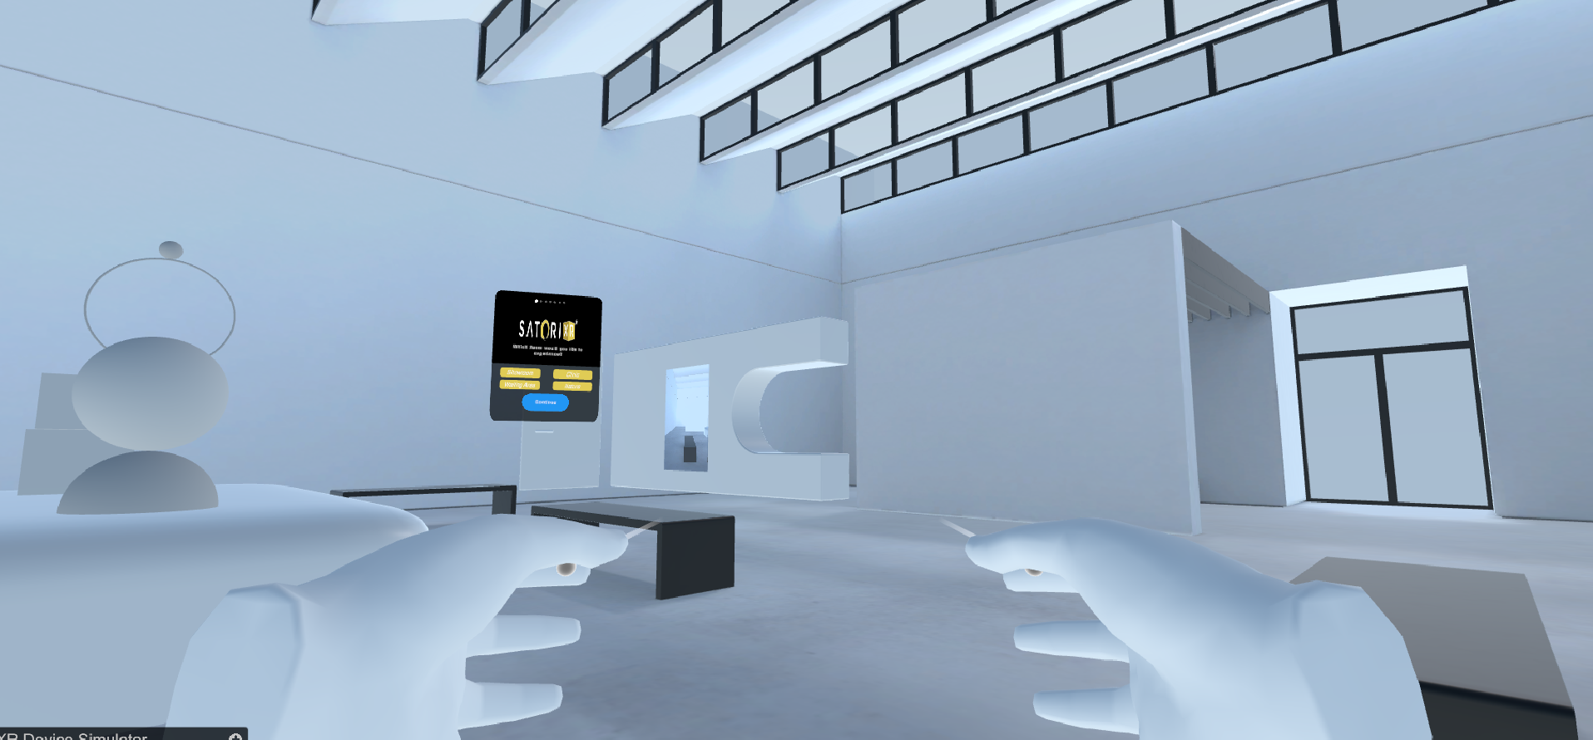
Implementation and Results
Use Cases
Showroom Environment Facilitates interactive product exploration and real-time customer engagement in a virtual retail space.

Slide 20
Conclusion & Future Work
Conclusion: The project successfully demonstrates an immersive environment tailored to diverse real-world scenarios like hospitals, nature trails, and showrooms. By leveraging VR technologies, it enhances user engagement, promotes spatial understanding, and provides an interactive medium for experiential learning and exploration.
Future Work: Future enhancements will include expanding to AR compatibility for wider device support, and improving environmental detail and physics-based interactions to elevate realism and usability.

Slide 21
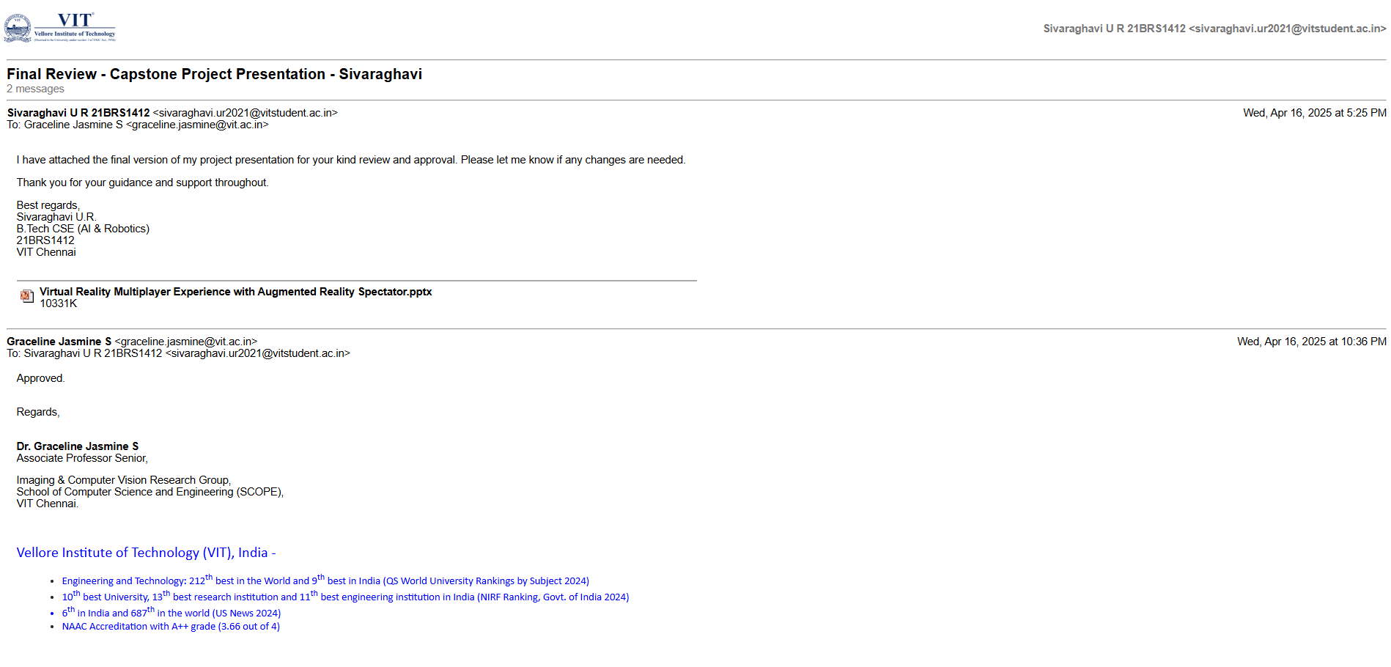
Guide Approval

Slide 22
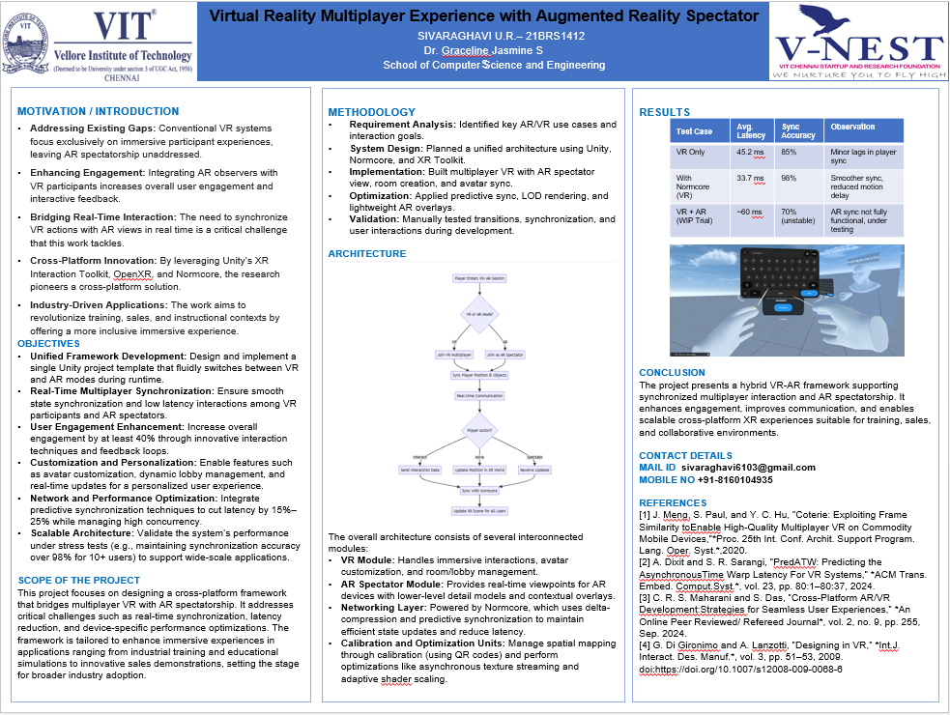

Slide 23
Research Paper Status
Paper Title:
“Virtual Reality Multiplayer Experience with Augmented Reality Spectator”
Current Status:
The research paper has been drafted and formatted in accordance with IEEE guidelines. It is currently under internal review and may undergo minor revisions based on feedback.
Submission Progress:
The manuscript has been submitted to the faculty guide for preliminary review. Further changes are being incorporated as per the suggestions provided, prior to the final submission for publication.

Slide 24
References
[1] D. Lee, A. K. Sanyal, E. A. Butcher, and D. J. Scheeres, “Finite-time controlfor spacecraft body-fixed hovering over an asteroid,” IEEE Transactions onAerospace and Electronic Systems, vol. 51, no. 1, pp. 506–520, Jan. 2015, doi:10.1109/TAES.2014.140197.
[2] S. Ker¨anen, “Content Management: Concept and Indexing Term Equivalence in aMultilingual Thesaurus,” Pantelidis, V. S., [(2009].
[3] Jason Jerald. The VR Book: Human-Centered Design for Virtual Reality. Asso-ciation for Computing Machinery, 2015.
[4] C. R. S. Maharani and S. Das, ”Cross-Platform AR/VR Development: Strategiesfor Seamless User Experiences,” *An Online Peer Reviewed / Refereed Journal*,vol. 2, no. 9, pp. 255, Sep. 2024.
[5] G. Di Gironimo and A. Lanzotti, ”Designing in VR,” *Int. J. Interact. Des. Manuf.*,vol. 3, pp. 51–53, 2009.
[6] I. R. Mukhametkhanov, M. R. Khafizov, and A. V. Shubin, ”Comparison of client-server solutions in the development of multiplayer online games on Unity,” *Elec-tronic Libraries*, vol. 25, no. 5, pp. 472–488, Dec. 2022.
[7] J. Smed, ”Networking for computer games,” *Int. J. Comput. Games Technol.*,vol. 2008, Art. ID 928712, p. 1, 2008. doi: 10.1155/2008/928712.
[8] Y. Liu and Y. Li, ”Virtual reality system for industrial training,” in *Proc. Int.Conf. Virtual Reality and Visualization (ICVRV)*, Qinhuangdao, China, 2020, pp.338-339.
[9] P. Pareek, ”Designing Multiplayer Experiences in AR and VR: Challenges andOpportunities,” *ShodhKosh: Journal of Visual and Performing Arts*, vol. 5, no.ICETDA24, pp. 360–366, May 2024

